Slide 2
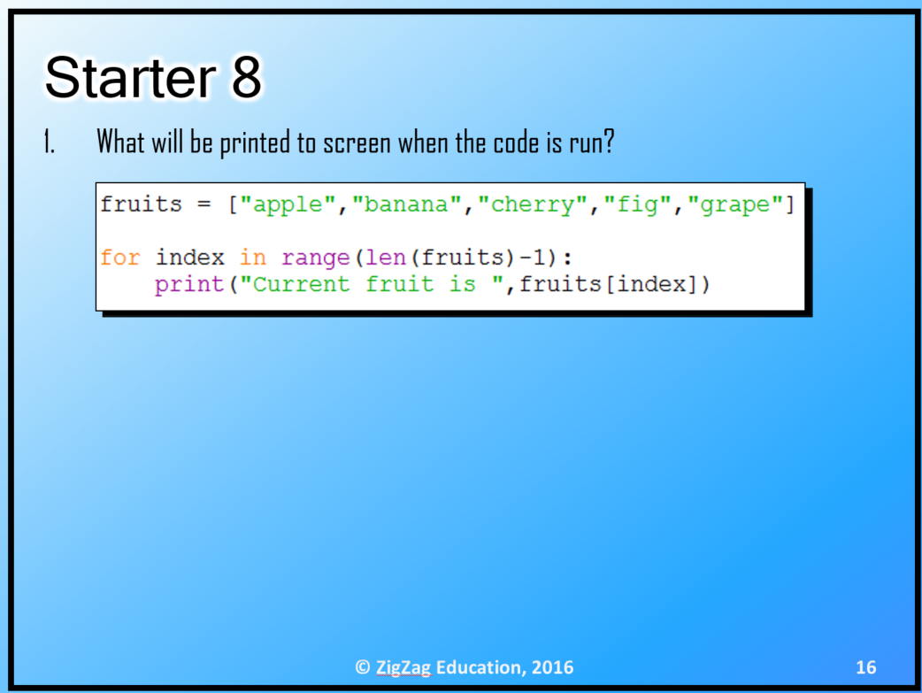
© Pearson Education Ltd 2020. Copying permitted for purchasing institution only.

Slide 3
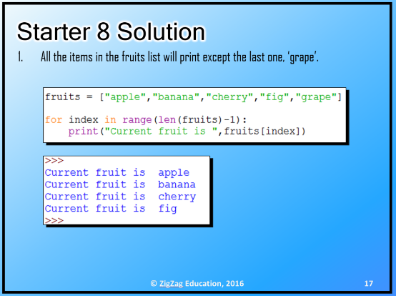
© Pearson Education Ltd 2020. Copying permitted for purchasing institution only.

Slide 4

Remember to write Titles, Objectives, dates and underline with a ruler!
This means that you will need to make notes in your exercise book.
This means that this is the section that you will need to make notes on in your exercise book
© Pearson Education Ltd 2020. Copying permitted for purchasing institution only.

Slide 5

Learning objectives
In this lesson students will learn to:
  Define the term 'function’
  Define the term 'parameter’
  Define the term 'return value’
  Create functions.
For more information on this topic, and additional student activities, see Topic 1.7 of the student book.
© Pearson Education Ltd 2020. Copying permitted for purchasing institution only.
Notes:
Specification content: 1.1.1 1.1.2 6.1.1 6.6.1 6.6.2

Slide 6
Repeating ourselves?
In your last lesson, you learned about procedures.
These are blocks of code that carry out an action. They are defined before the main program.
Today, you are going to look at the other kind of subprogram: functions.
© Pearson Education Ltd 2020. Copying permitted for purchasing institution only.

Slide 7
Functions
A function is a subprogram.
Functions are created in the same way as procedures, using the def command before the main program.
They have input parameters, just as procedures can.
A function has a return value.
When a function completes its task, the result is returned to the calling code.
© Pearson Education Ltd 2020. Copying permitted for purchasing institution only.

Slide 8
Functions
You have used Python built-in functions before. There are lots of them!
Examples include:
userChoice = input("Enter your choice: ")
attendance = float(“0.85”)
missedAssignments = int(“1”)
print(len(exampleString))
print(exampleString.isalpha())
print(exampleString.lower())
© Pearson Education Ltd 2020. Copying permitted for purchasing institution only.
Notes:
Student Activity 1

Slide 9
Return values
In the examples on the previous slide, each function returns something. This is what makes them functions.
But what does this actually mean?
Once the function has finished its task, a value is sent back.
This return value is sent back to the line in the program from which it was called.
In our examples, each function call is assigned to a variable or is printed. This is where the return value ends up.
© Pearson Education Ltd 2020. Copying permitted for purchasing institution only.
Notes:
Student Activity 1

Slide 10
User-defined functions - example
Function definitions are the same as procedure definitions, with one extra part – they must return a value of some kind.
# Constants
VAT = 0.2
# Global variables
subtotal = 34.99
finalBill = 0.0
# Subprograms
def addVAT (bill):
total = 0.0
total = bill + (bill * VAT)
return (total)
# Main program
finalBill = addVAT (subtotal)
print (finalBill)
Functions look the same as procedures.
The return value.
The function call is assigned to a variable so that the return value can be used.
© Pearson Education Ltd 2020. Copying permitted for purchasing institution only.
Notes:
Student Activity 2

Slide 11

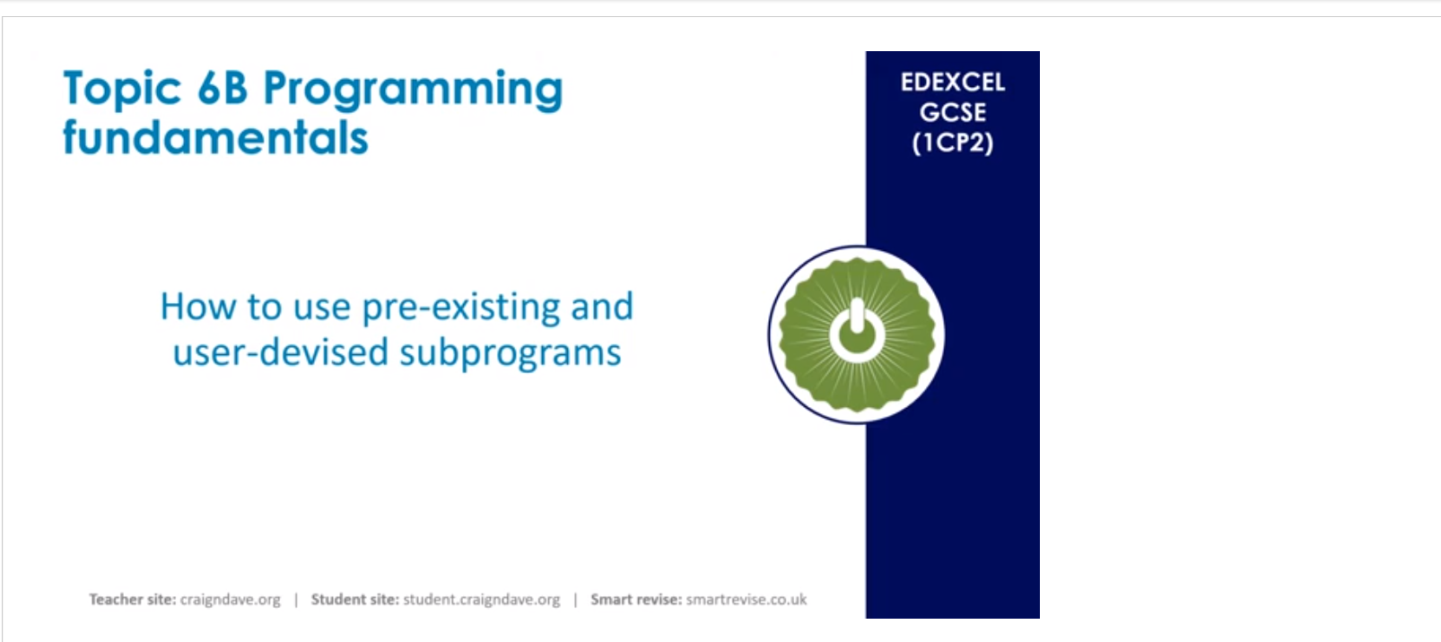
https://student.craigndave.org/videos/gcse-edexcel-topic-6b-how-to-use-pre-existing-and-user-devised-subprograms
© Pearson Education Ltd 2020. Copying permitted for purchasing institution only.

Slide 12
Variables and subprograms
You might have noticed that there are a lot of variables in this example.
It is important to understand that the variables inside a subprogram do not exist outside of it.
Think of subprograms as black boxes. Arguments go in, return values may come out. What happens inside cannot be accessed by the rest of the program.
Giving different names to variables inside and outside of subprograms helps make debugging much easier.
# Constants
VAT = 0.2
# Global variables
subtotal = 34.99
finalBill = 0.0
# Subprograms
def addVAT (bill):
total = 0.0
total = bill + (bill * VAT)
return (total)
# Main program
finalBill = addVAT (subtotal)
print (finalBill)
© Pearson Education Ltd 2020. Copying permitted for purchasing institution only.
Notes:
https://student.craigndave.org/videos/gcse-edexcel-topic-6b-how-to-use-pre-existing-and-user-devised-subprograms
Student Activity 3

Slide 13
Wrap up: you have learned how to…
Define the term 'function’.
  Similar to a procedure: a block of code defined before the main program that can be reused. The difference is that functions return a value.
Define the term 'parameter’.
  A value passed into a function or procedure.
Define the term 'return value’.
  The output of a function.
Create functions.
  Using the def keyword and the return keyword.
© Pearson Education Ltd 2020. Copying permitted for purchasing institution only.

